Slide 1
RFID Field strength Measurement Tag
Tijmen Verhulsdonck, Dhananjay Kittur, Binayak Ghosh

Slide 2
Goal of this Project
To create an integrated solution
To measure Field Strength of an RFID reader antenna of any length and width
Present the data in a 3D graph

Slide 3
Description
RFID reader used to power the antenna and generate a field
A start signal is sent to the microcontroller to start sampling the voltages via AM modulation
3D tag, connected to microcontroller, used read voltage values on three axes
Microcontroller reads and processes the measured voltage values
The 3D RF field measurement is plotted to represent the data in four dimension scattered graph

Slide 4
Block Diagram
AM Demodualtion
Microcontroller samples voltage values
Send ‘START’ signal
3D Tag
Sends the voltage readings to the software application
Stores voltage readings via voltage divider circuit
Software plots 4d scattered Graph of the measured RF field

Slide 5
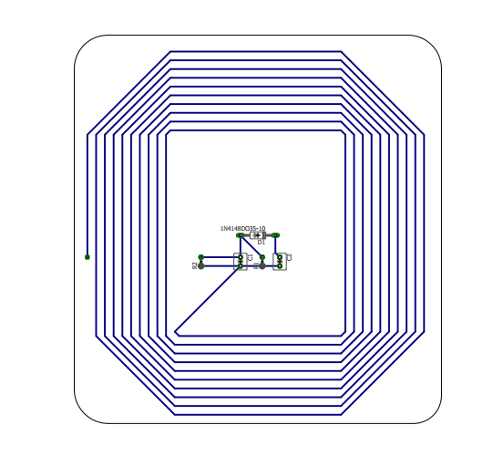
Layout of Tag Antenna

Slide 6
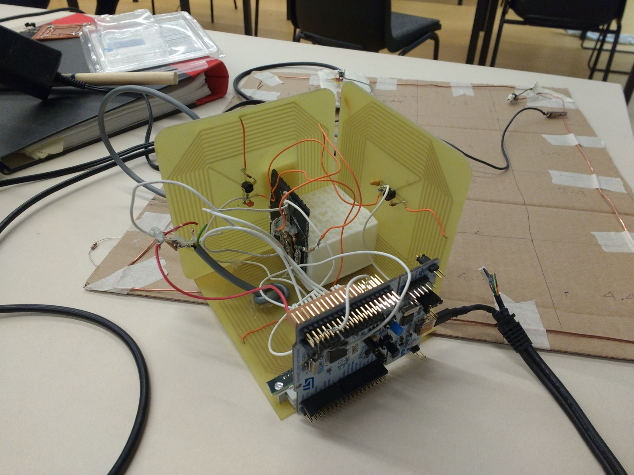
Three Dimensional Tag

Slide 7
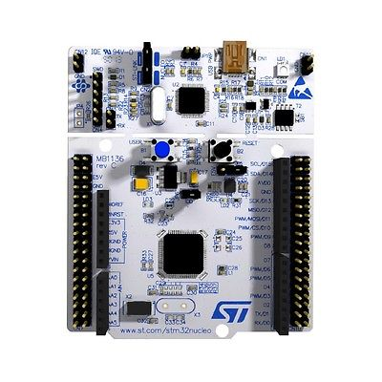
Microcontroller Circuit Nucleo STM32L476RG
A2,A3,A4-Voltmeter
A5-AM Mod

Slide 8
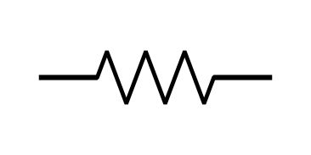
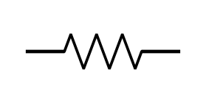

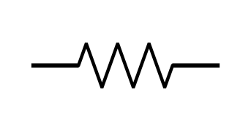
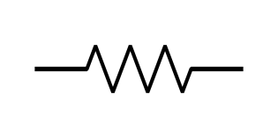

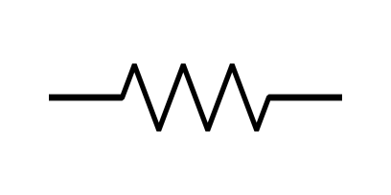
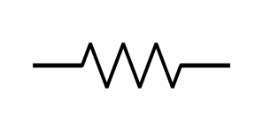

Voltage Divider Circuit
V_O1
R1
R2
V_XY
V_O2
R1
R2
V_YZ
V_O3
R1
R2
V_ZX

Slide 9
AM Demodulation Circuit

Slide 10
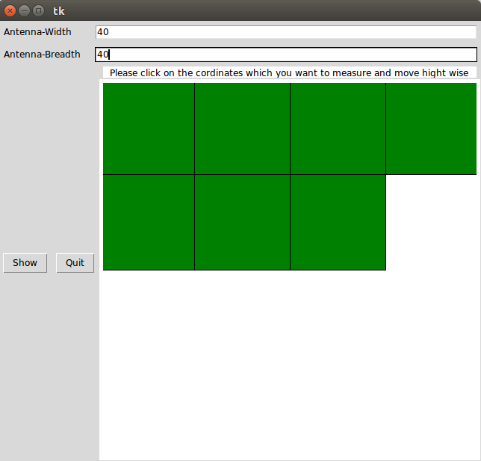
Graphical User Interface

Slide 11
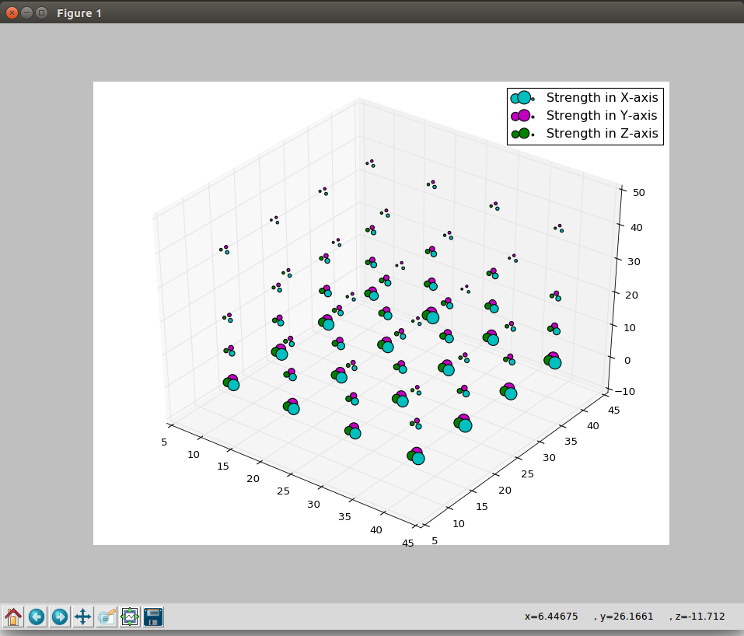
4-Dimensional Scattered Graph

Slide 12
Voltage Readings Received

Slide 13
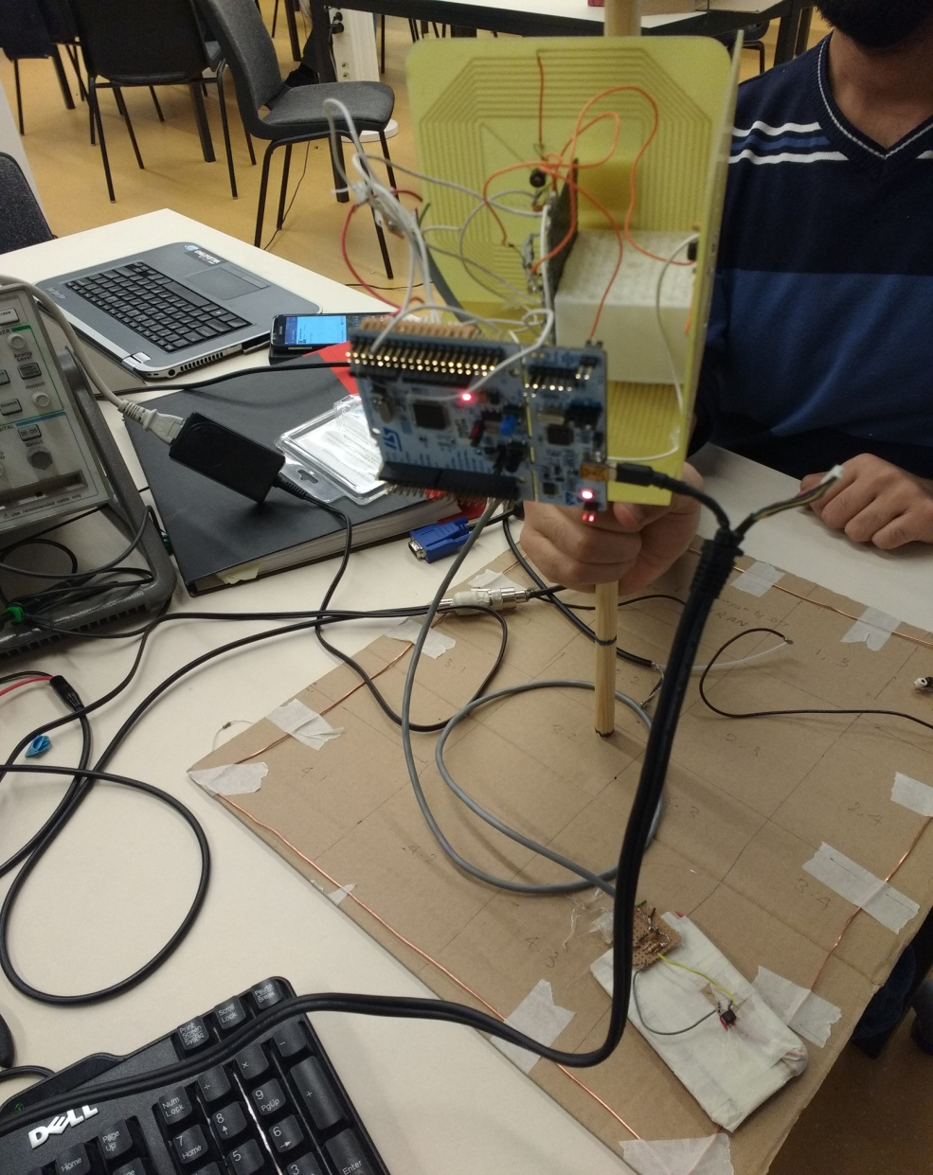
Final Prototype

